Slide 1
유전체분석 R 파트3, 4회차
시간: 2015년 7시 30분
장소: 토즈 신촌본점
Epigenomics/DNA methylation 이론
* (Edx:PH525.7x) Case study: ChIP-seq data analysis

Slide 2
Topics
Epigenetics (생물학적 이론)
Epigenetics관련 NGS 분석 원리
NGS 분석을 활용한 연구 실례

Slide 3
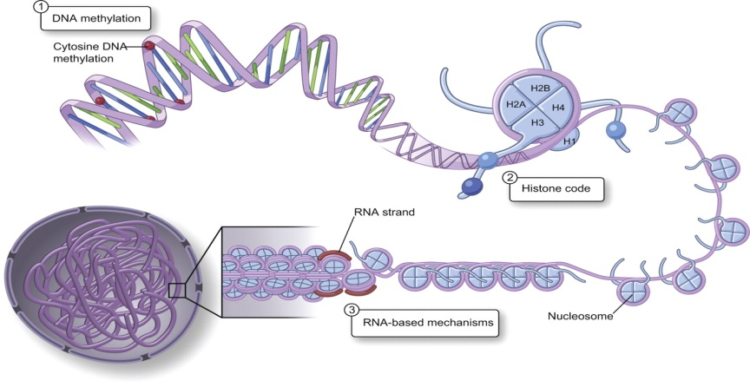
Epigenetics
The prefix epi is derived from the Greek preposition meaning: above, on, over, nearby.
“Epigenetics” refers to covalent modification of DNA, protein, or RNA, resulting in changes to the function and/or regulation of these molecules, without altering their primary sequences.

Slide 4
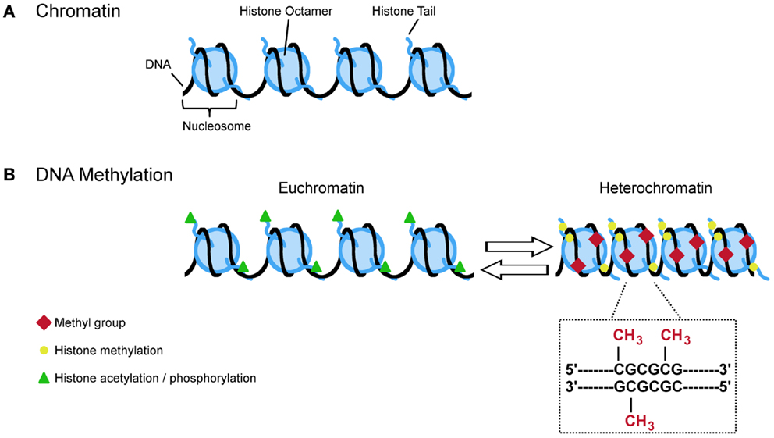
DNA Methylation and Histone modification

Slide 5
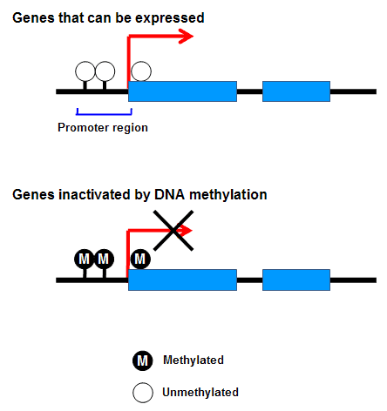
The Role of Methylation in Gene Expression

Slide 6
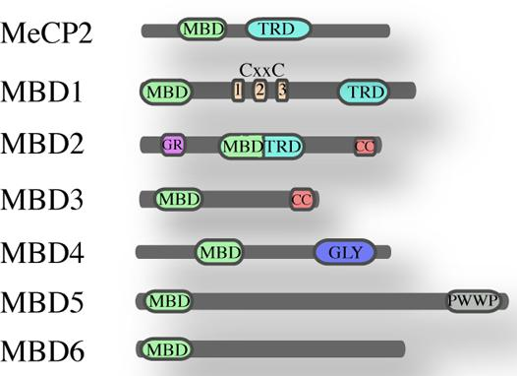
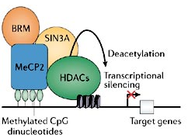
Methyl CpG binding Proteins
Roberta M and Hendrik G., 2014
Kamal K.E. Gadalla et al., 2011

Slide 7
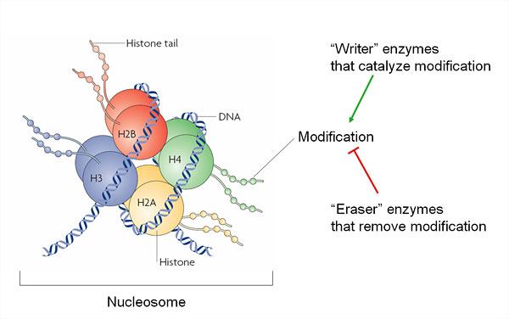
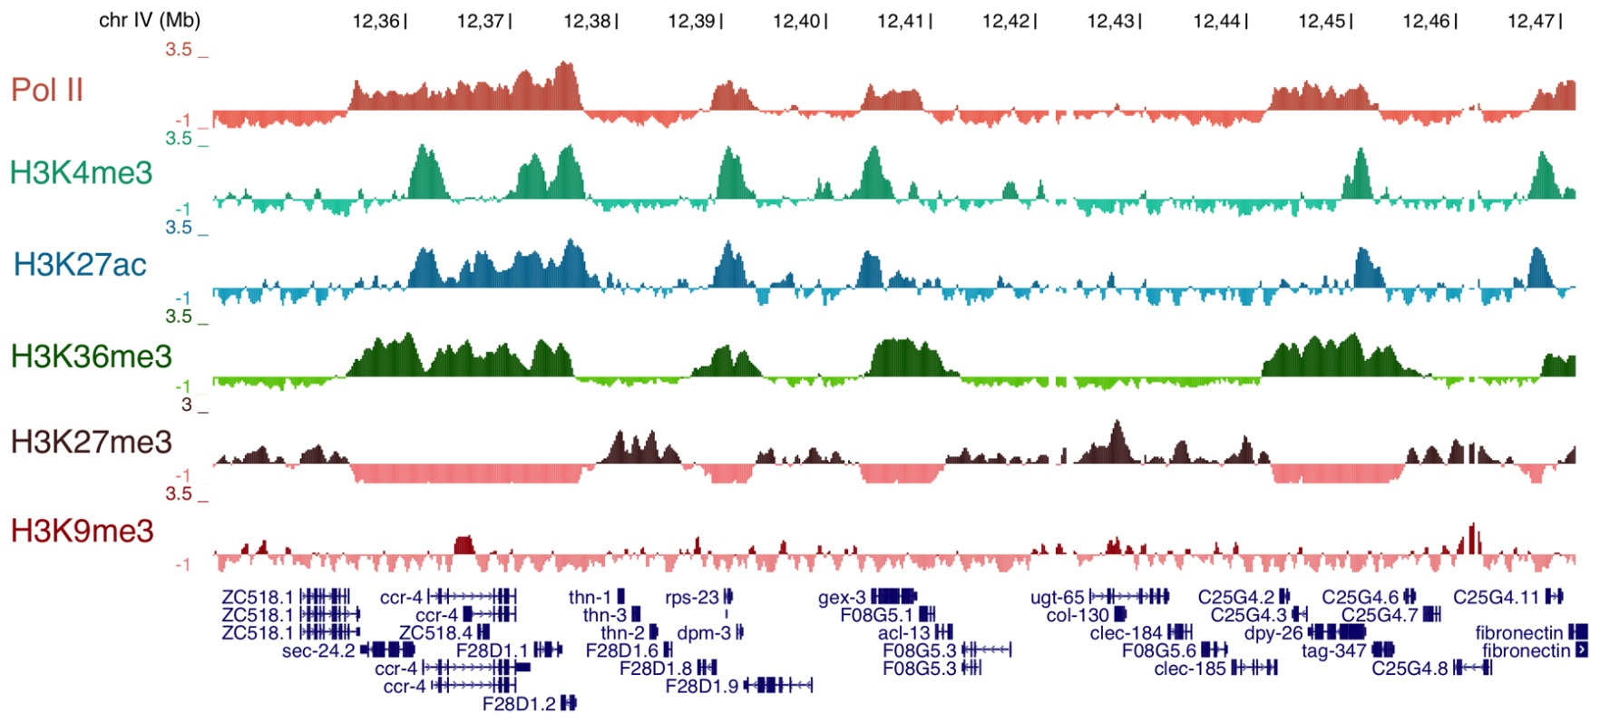
Histone unit and modification

Slide 8
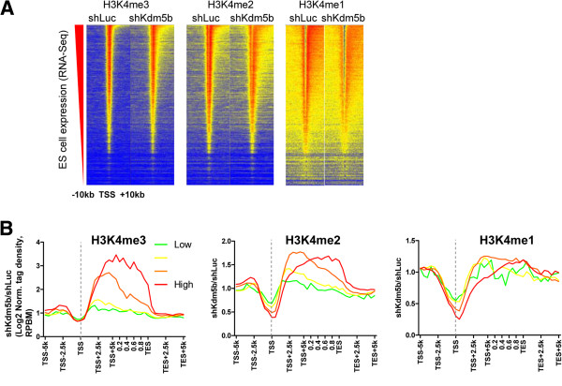
Epigenetics and gene expression regulation

Slide 9
Epigenetics관련 NGS 분석 원리
DNA methylation 분석을 위한 Bisulfite conversion.
Histone modification 분석을 위한 Chromatin immunoprecipitation.
NGS library제작 및 NGS 기초 분석

Slide 10
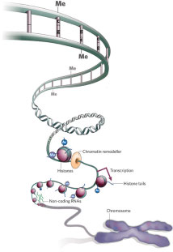
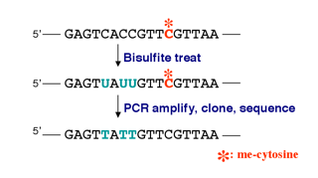
Bisulfite Sequencing

Slide 11
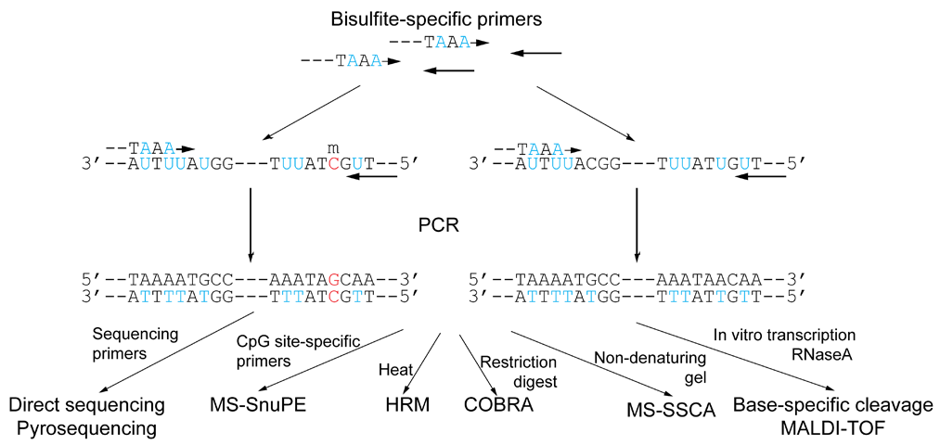
DNA methylation analysis methods

Slide 12
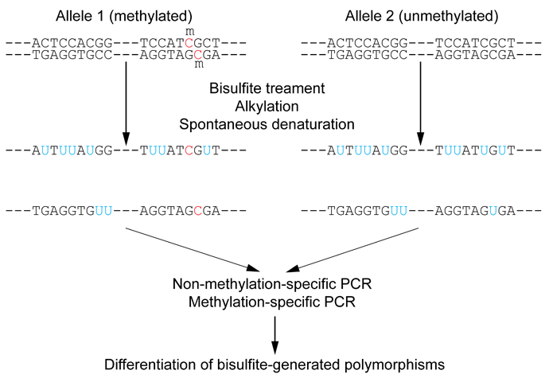
Outline of bisulfite conversion of sample sequence of genomic DNA

Slide 13
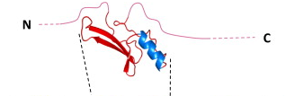
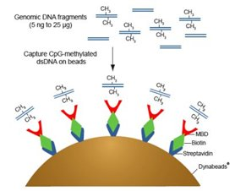
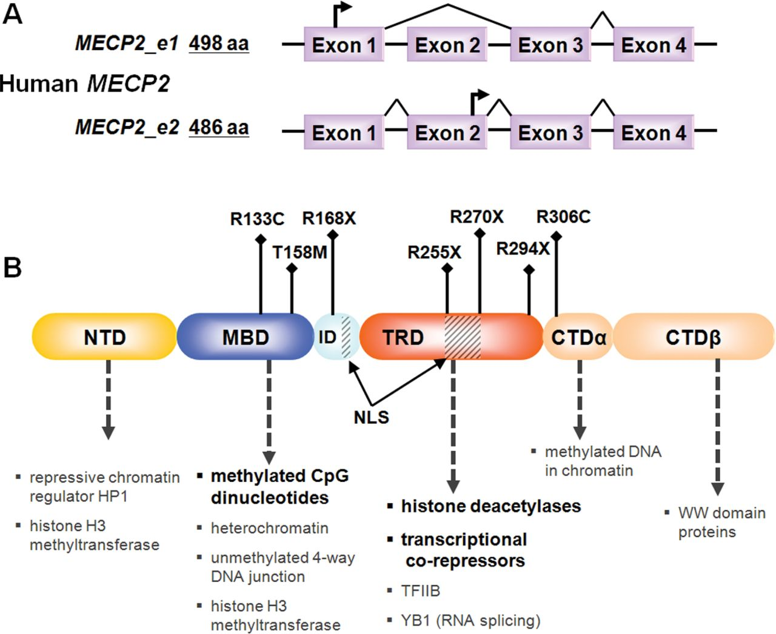
MBD-seq
Xin Xu and Lucas Pozzo-Miller, 2013

Slide 14
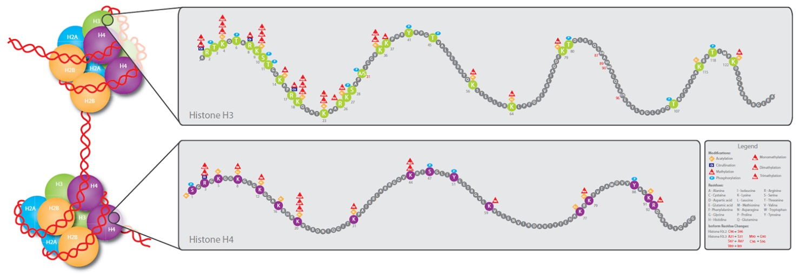
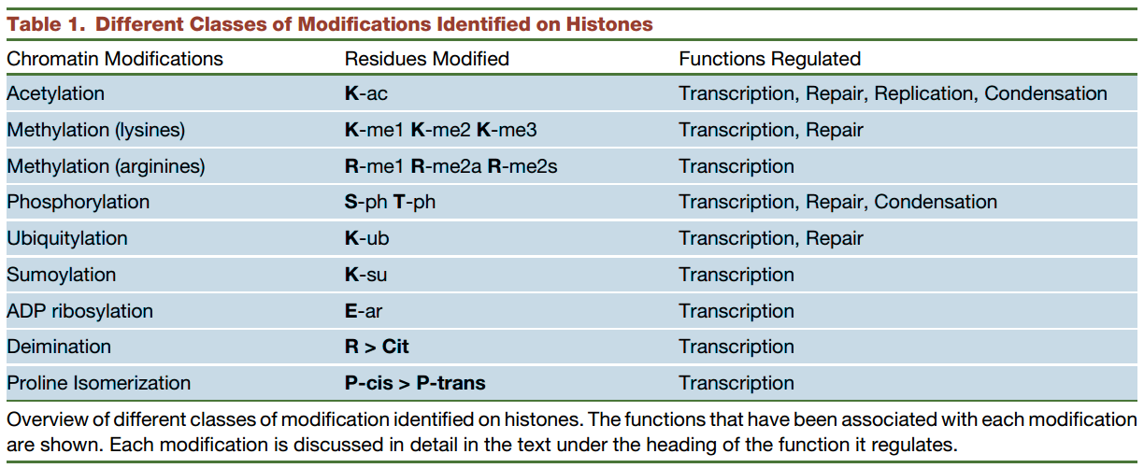
Histone Post translational Modification chart & antibodies
http://www.rockland-inc.com/epi-plus.aspx

Slide 15
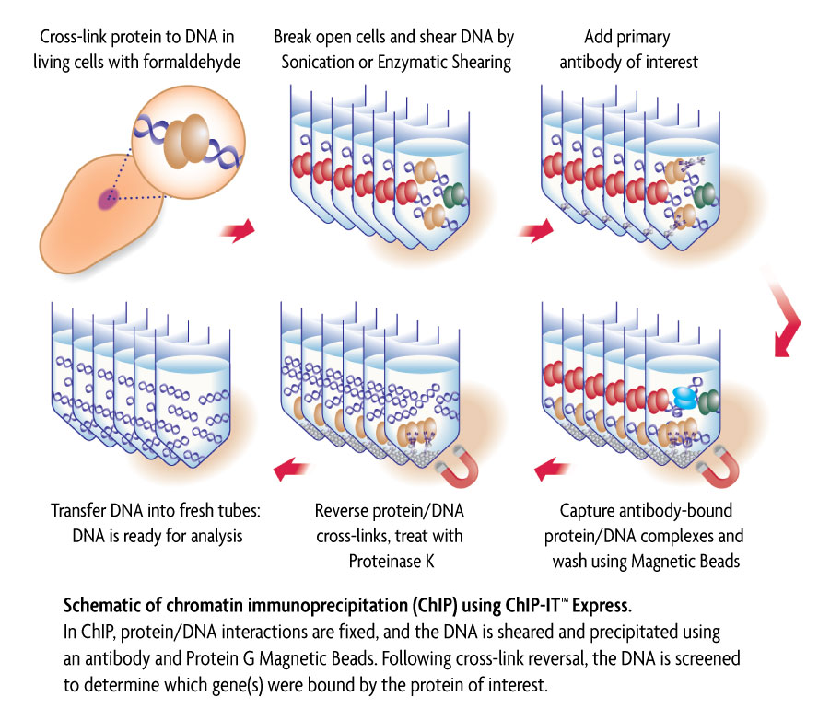
ChIP assay
Activemotif.com

Slide 16
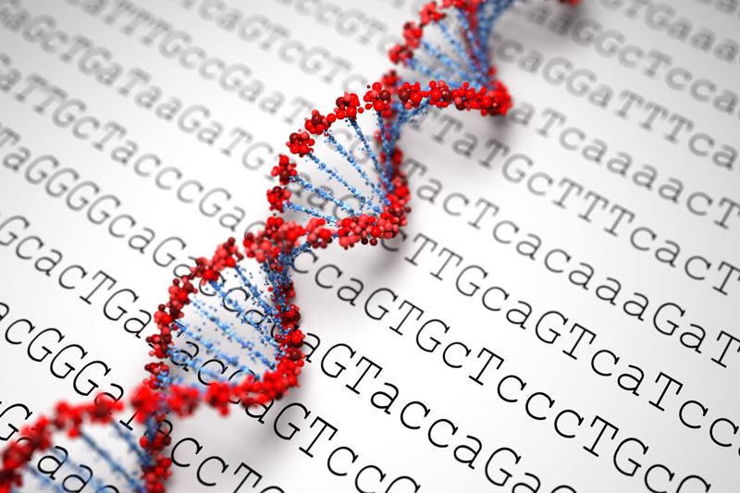
Title:
Genome-wide Analysis of XXX binding

Slide 17
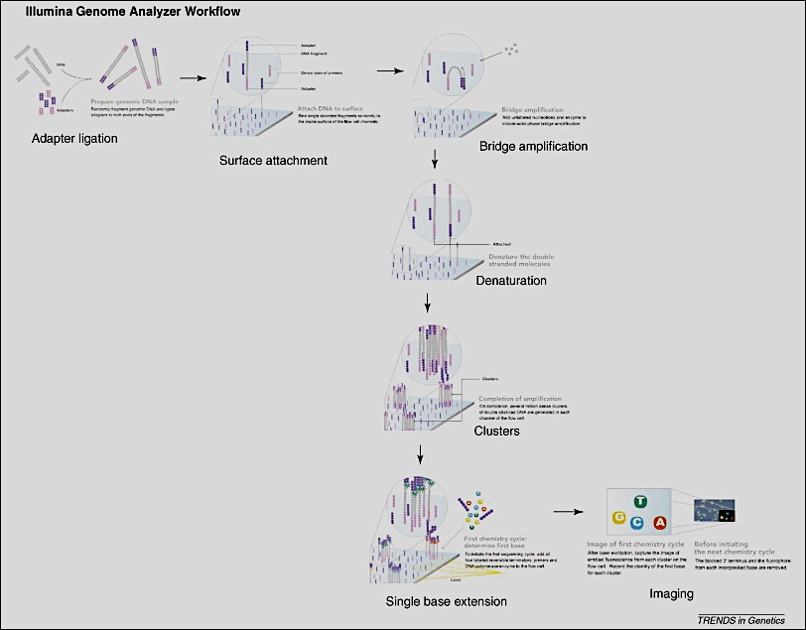
Illumina Genome Analyzer Workflow
Elaine R. Mardis, 2008

Slide 18
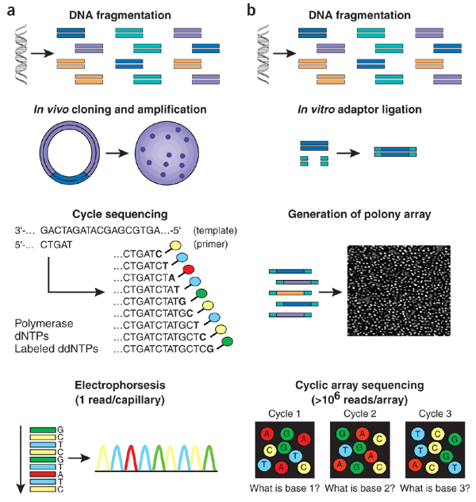
Sanger vs. Next Gen
Jay Shendure & Hanlee Ji, 2008

Slide 19
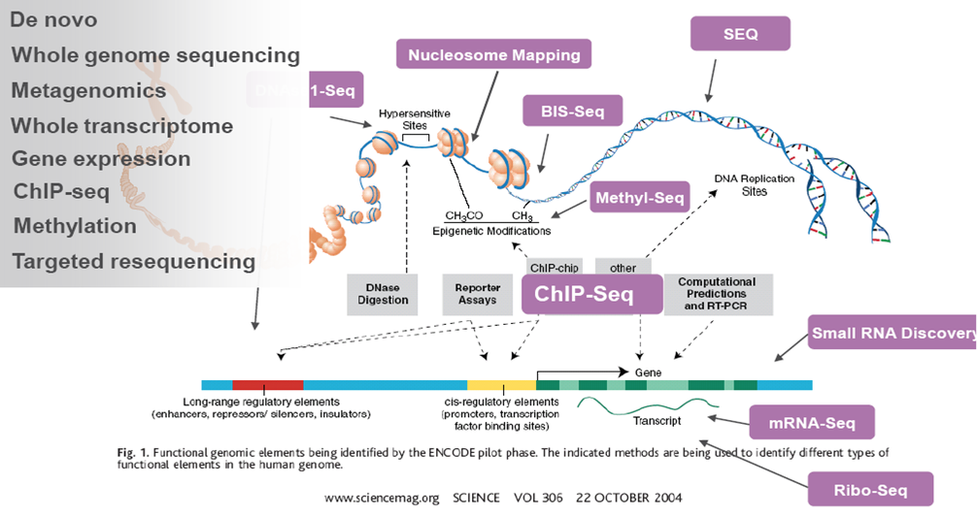
Sequencing as a Powerful Methodology

Slide 20
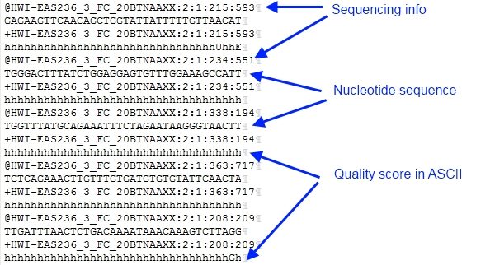
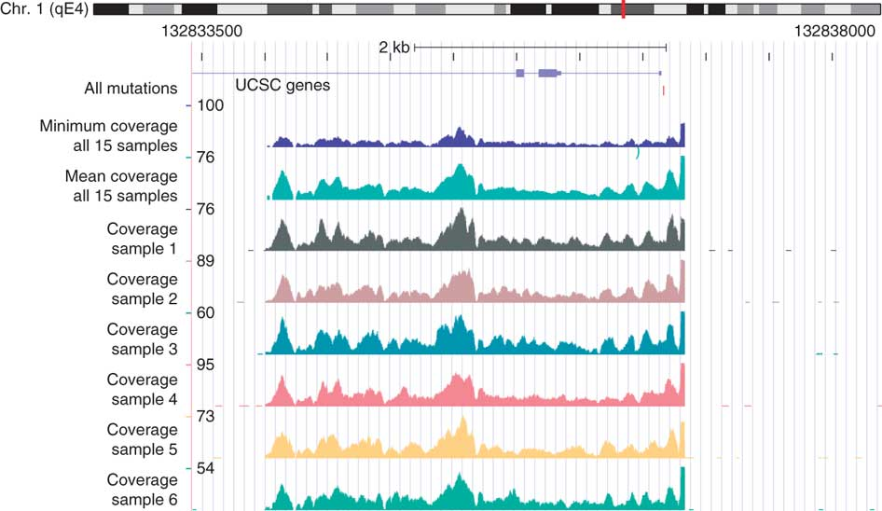
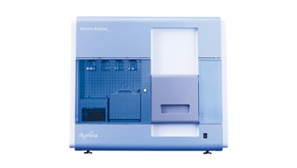
Information flow of sequencing data
fastq
SAM/BAM
coverage
HISEQ2:197:D08GUACXX:8:2105:21056:104282 0 chr10 3000101 255 51M * 0 0 AAGGTCACCAAAGGCCCACCTTGTCTTTACCTTATTTGTTCTAAATTTTTT =@@DA:ADDHD;AA?:AAFHGIHHBDEFHIDGB9CFH<?F<DEEIGGHEII XA:i:0 MD:Z:51 NM:i:0
HISEQ2:197:D08GUACXX:6:1105:9303:81340 0 chr10 3000301 255 51M * 0 0 GTGTTATTTCACAAGGTGAAGATAGAGCTTGGTGGCTGCCAGAGAGATTAA BB@FFFFFHHHHHJJJFGIJIIJJJJJJIJJJHIJJJIIJJJJIGIGIJII XA:i:0 MD:Z:51 NM:i:0
HISEQ2:197:D08GUACXX:7:2102:2396:174630 16 chr10 3000373 255 51M * 0 0 CTGAATCTTCTCCTAAGTATCATCCTGAAGAACAAAATTCCTCTTTTGCTT JJIJJJJJJJJJJJJJJJIIJJJJJIJJJJJHJJJJJJHHHHHFFFFFCCC XA:i:0 MD:Z:51 NM:i:0
HISEQ2:197:D08GUACXX:8:2108:12162:127556 0 chr10 3000388 255 51M * 0 0 AGTATCATCCTGAAGAACAAAATTCCTCTTTTGCTTAAAATTCACTGGGGA @@?DDFFDBHFFGJIIGIGGGGGIJGHHIHIIGEGIIIIIJJJIIJIGGGG XA:i:0 MD:Z:51 NM:i:0
Image analysis

Slide 21
fastq
Raw sequence format

Slide 22
What is FASTQ?
Text-based format for storing both biological sequences and corresponding quality scores.
FASTQ = FASTA + QUALITY
A FASTQ file uses four lines per sequence.
1
@SEQ_ID
GATTTGGGGTTCAAAGCAGTATCGATCAAA
+SEQ_ID(Optional)
!''*((((***+))%%%++)(%%%%).1**
2
3
4

Slide 23
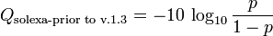
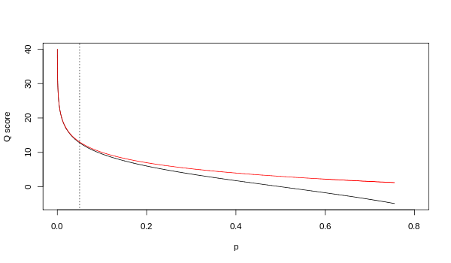
Quality score calculation
+SEQ_ID
!''*((((***+))%%%++)(%%%%).1**
?
A quality value Q is an integer representation of the probability p that the corresponding base call is incorrect.
1
2
Sanger
Solexa
Figures from Wikepedia

Slide 24
Quality score interpretation
Phred Quality Score | Probability of incorrect base call | Base call accuracy
10 | 1 in 10 | 90%
20 | 1 in 100 | 99%
30 | 1 in 1000 | 99.9%
40 | 1 in 10000 | 99.99%
50 | 1 in 100000 | 99.999%
Materials from Wikepedia

Slide 25
Sam/bam
Alignment format

Slide 26
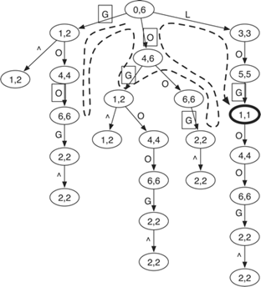

Short read alignment
FASTQ files
Index
Alignments
Genomic reference sequence
Many choices: BWA, Bowtie, Maq, Soap, Star, Tophat, etc.

Slide 27
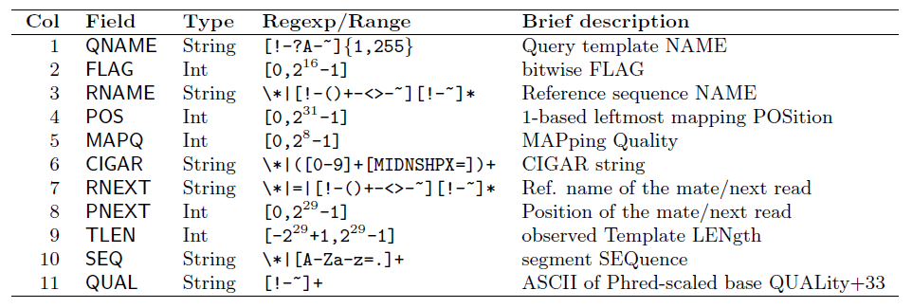
The SAM specification
https://github.com/samtools/hts-specs
An example line:
MARILYN_0005:2:77:7570:3792#0 97 1 12017 1 76M = 12244 303 ACTTCCAGCAACTGCTGGCCTGTGCCAGGG
TGGAAGCTGAGCACTGGAGTGGAGTTTTCCTGTGGAGAGGAGCCAT IHGIIIIIIIIIIIIGGDBDIIHIIEIGDG=GGDDGGGGEDE>CGDG<GBGGBGDEEGDFFEB>2;C<C;BDDBB8
AS:i:-5 XN:i:0 XM:i:1 XO:i:0 XG:i:0 NM:i:1 MD:Z:32C43 YT:Z:UU XS:A:+ NH:i:3 CC:Z:15 CP:i:102519078 HI:i:0
N = hundreds of millions

Slide 28

The SAM format
mismatch
Indel: insertion, deletion
5. CIGAR: description of alignment operations
1. seqid
6. sequence
7. quality
Short read
? 4. mapping quality
3. position
Reference sequence
2. chromosome

Slide 29
BAM: the binary version of SAM
SAM files are large: 1M short reads => 200MB; 100M short reads => 20GB.
Makes sense for compression
BAM: Binary sAM; compress using gzip library.
Two parts: compressed data + index
Index: random access (visualization, analysis, etc.)

Slide 30
wiggle
Coverage format

Slide 31
From alignment to read depth
Read depth: the number of times a base-pair is covered by aligned short reads.
Can be normalized: depth / library size * 1E6 = read depth per million aligned reads.
Many tools to use: samtools depth, bedtools, and so on.
Example:
1
2
3
4
Alignments
Reference:
Notes:
After the short reads have been aligned to the reference sequences, we can convert the alignment information into read depth which basically tells you the number of times a base pair is covered by aligned short reads. Sometimes, this depth can be further normalized using the library size to get the read depth per million aligned reads. The purpose of doing this is to remove the effect of different library sizes so that two sequencing samples can be compared. There are many tools you can use to do this, such as the samtools depth or bedtools. Here is an example of the read depth calculation. Assuming we have four short reads aligned to the reference, then the depth at these four different positions are 1, 2, 3 and 4.

Slide 32
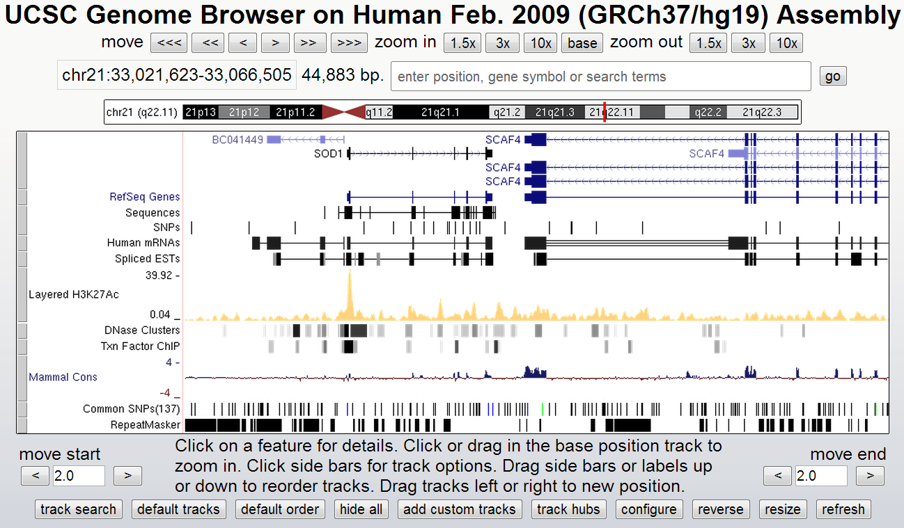
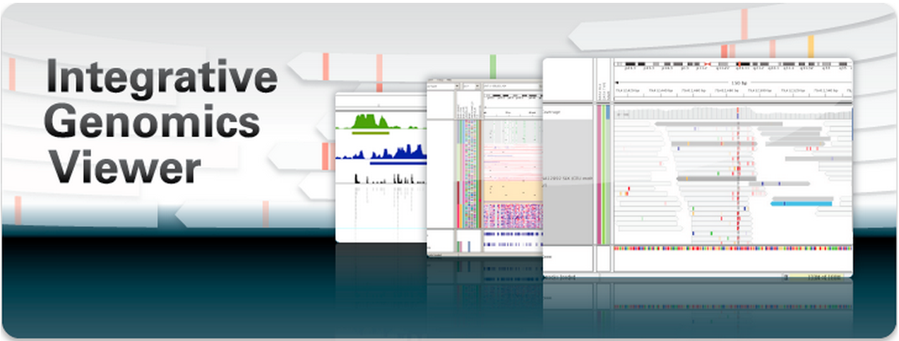
Genome browser
UCSC genome browser
Pros: very comprehensive
Cons: data have to be transmitted via network
v.s.
Pros: locally installed
Cons: less genome annotation

Slide 33
HOMER
1) Mapping to the genome (NOT performed by HOMER, but important to understand)
2) Creation Tag directories, quality control, and normalization. (makeTagDirectory)
3) UCSC visualization (makeUCSCfile, makeBigWig.pl)
4) Peak finding / Transcript detection / Feature identification (findPeaks)
5) Motif analysis (findMotifsGenome.pl)
6) Annotation of Peaks (annotatePeaks.pl)
7) Quantification of Data at Peaks/Regions in the Genome/Histograms and Heatmaps (annotatePeaks.pl)
8) Quantification of Transcripts and Repeats (analyzeRNA.pl, analyzeRepeats.pl)

Slide 34
1) Mapping to the genome (NOT performed by HOMER, but important to understand)
Popular short read aligners
bowtie : fast, works well bowtie2 : fast, can perform local alignments too BWA - Fast, allows indels, commonly used for genome/exome resequencing Subread - Very fast, (also does splice alignment) STAR - Extremely fast (also does splice alignment, requires at least 30 Gb memory)

Slide 35
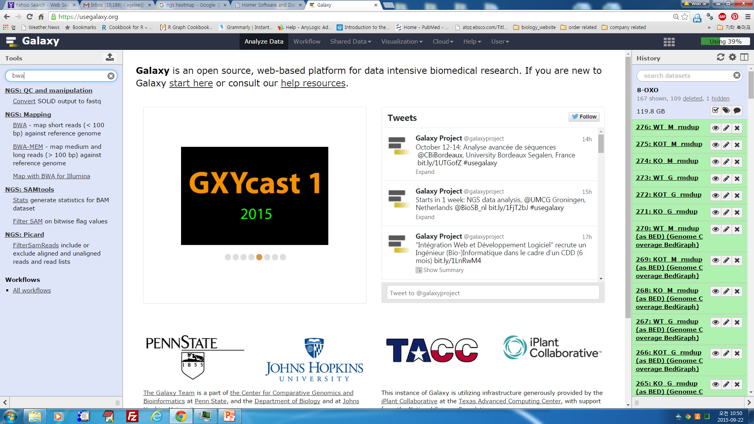
1) Mapping to the genome (NOT performed by HOMER, but important to understand)
Example of alignment with BWA
Step 1 - Build Index (takes a while, but only do this once):
bwa index -a bwtsw genome.fa
Step 2 - Align reads to the index (perform for each experiment):
# where the genome.fa is in the same directory with your index from the first step
bwa mem -t #cpus genome.fa reads.fq > aln-se.sa
#paired end bwa mem -t #cpus genome.fa reads1.fq reads2.fq > aln-pe.sam

Slide 36
2) Creation Tag directories, quality control, and normalization. (makeTagDirectory)
Creating Tag Directories
An example: makeTagDirectory Macrophage-PU.1-ChIP-Seq/ pu1.lane1.bed pu1.lane2.bed pu1.lane3.bed
Several additional options exist for makeTagDirectory. The program attempts to guess the format of your alignment files, but if it is unsuccessful, you can force the format with "-format <X>". makeTagDirectory Macrophage-PU.1-ChIP-Seq/ pu1.lane1.bed pu1.lane2.bed pu1.lane3.bed -format bed
makeTagDirectory Macrophage-H3K4me1-ChIP-Seq/ s_1_sequence.align.sam -format sam

Slide 37
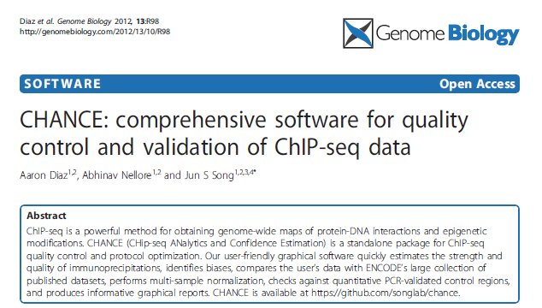
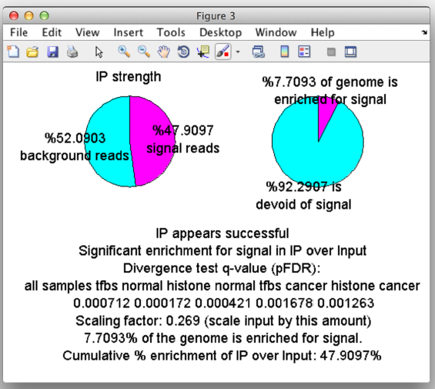
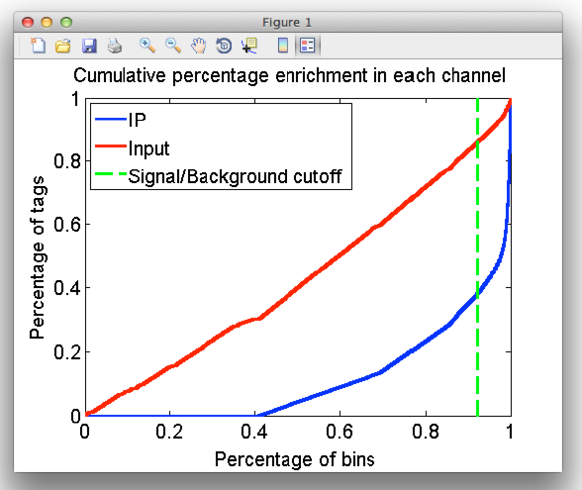
2) Creation Tag directories, quality control, and normalization. (makeTagDirectory)

Slide 38
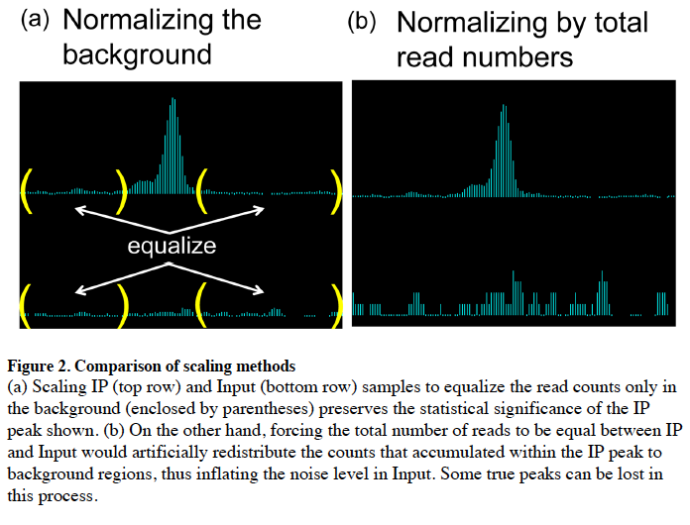
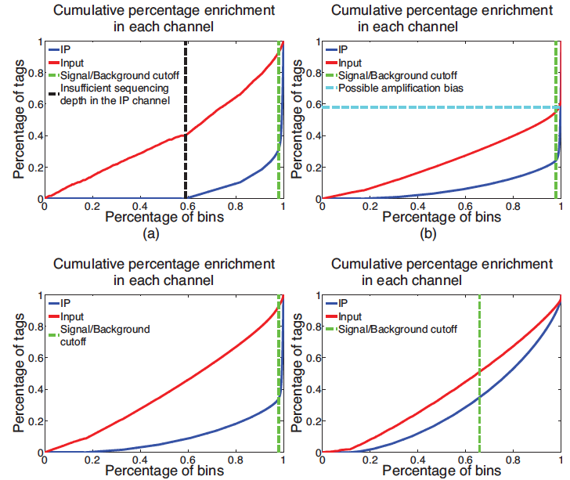
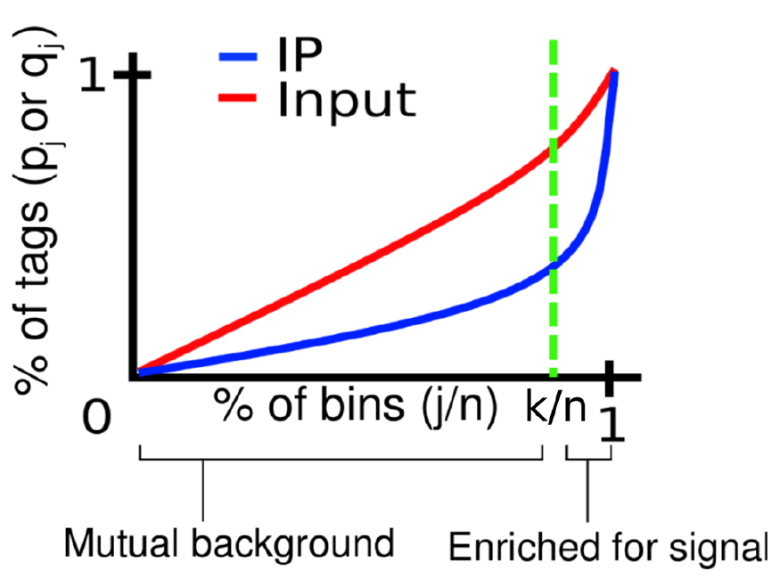
2) Creation Tag directories, quality control, and normalization. (makeTagDirectory)
Quality control and validation of ChIP-seq data
Using CHANCE(CHip-seq Analytics and Confidence Estimation)
A
B
Normalizing by total read numbers.
Normalizing the background.
Insufficient sequencing depth in the IP
Amplication bias
Low IP signals
Ideal IP signals
C
D
E
F
Diaz A. et al., 2012

Slide 39
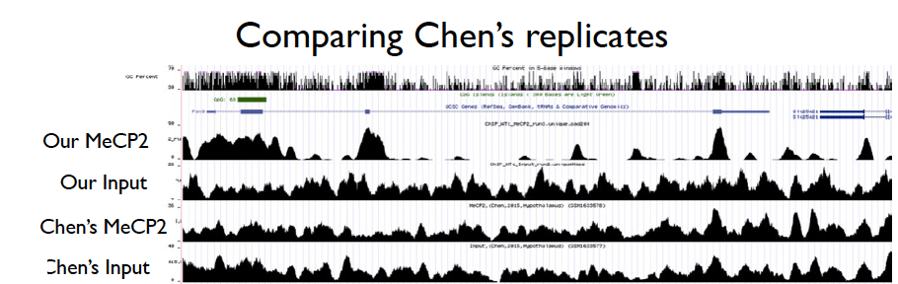
2) Creation Tag directories, quality control, and normalization. (makeTagDirectory)

Slide 40
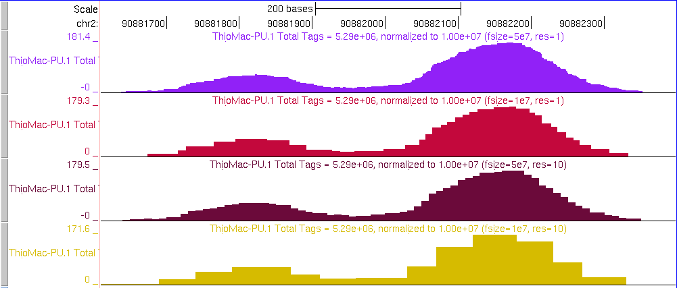
3) UCSC visualization (makeUCSCfile, makeBigWig.pl)
2) Creation Tag directories, quality control, and normalization. (makeTagDirectory)
Visualizing Experiments with a Genome Browser
Making Genome Browser Files
The basic strategy HOMER uses is to create a bedGraph formatted file that can then be uploaded as a custom track to the genome browser. This is accomplished using the makeUCSCfile program. To make a ucsc visualization file, type the following:
makeUCSCfile <tag directory> -o auto i.e. makeUCSCfile PU.1-ChIP-Seq/ -o auto (output file will be in the PU.1-ChIP-Seq/ folder named PU.1-ChIP-Seq.ucsc.bedGraph.gz)

Slide 41
3) UCSC visualization (makeUCSCfile, makeBigWig.pl)
Visualizing Experiments with a Genome Browser
Creating bigWig files with HOMER Before even trying to make bigWigs, you must download the bedGraphToBigWig program from UCSC and place it somewhere in your executable path (i.e. the /path-to-homer/bin/ folder). This called directly by HOMER to create the BigWig files. Using the makeBigWig.pl Script
To make bigWig files easier to generate, HOMER includes a program creatively named "makeBigWig.pl" that automates all of the steps below. makeBigWig.pl <tag directory> <genome> [special options] [makeUCSC file options] -webDir /path-to-web-fold/ -url http://webserverURL/bigwigFold/
i.e. makeBigWig.pl PU.1-ChIP-Seq/ mm9 -webDir /var/www/bigWigs/ -url http://ChuckNorrisU.edu/bigWigs/

Slide 42
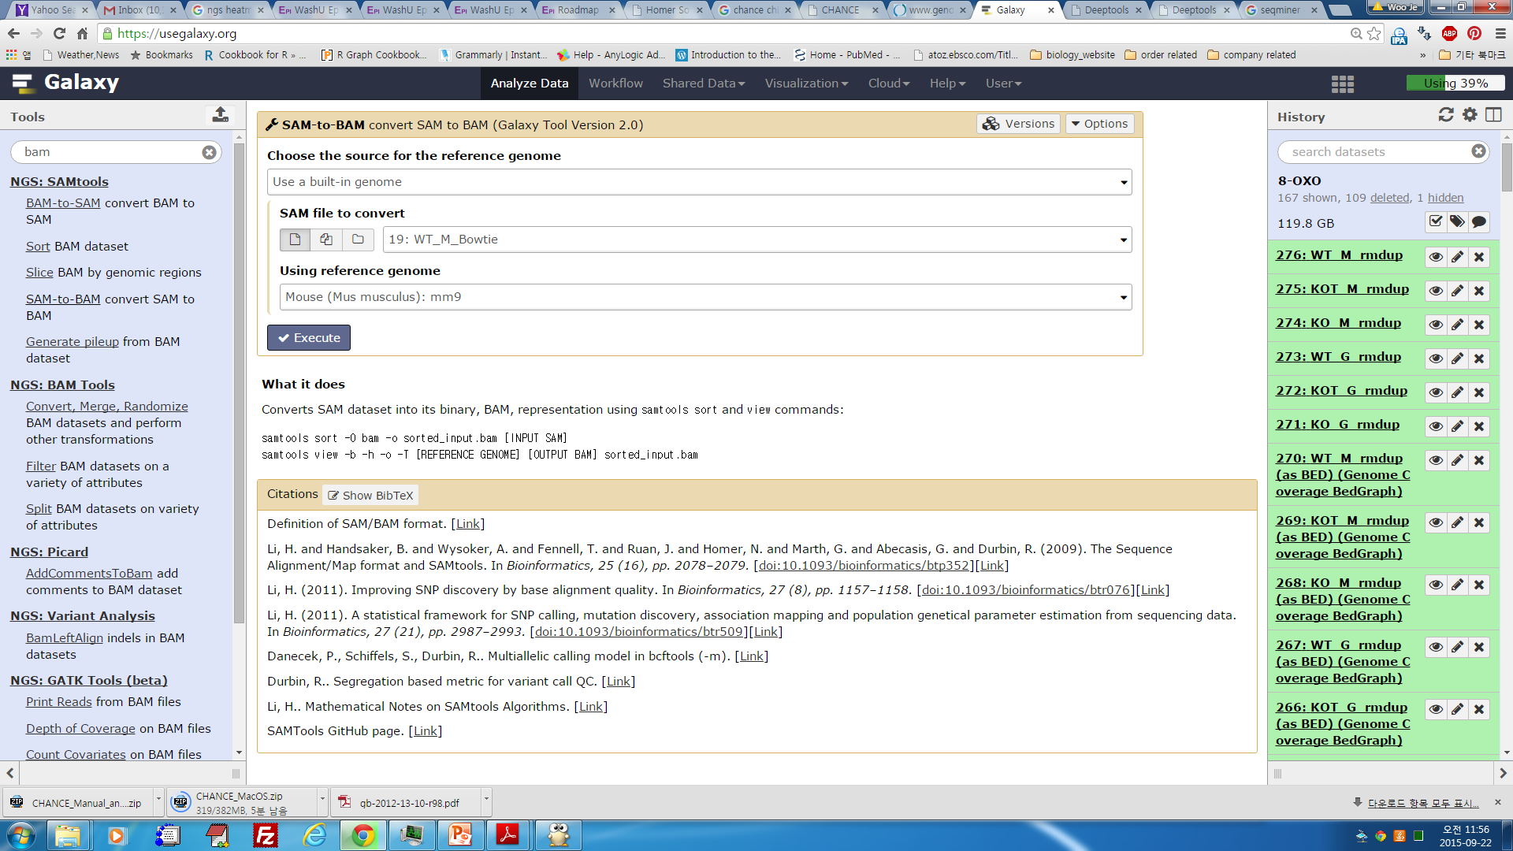
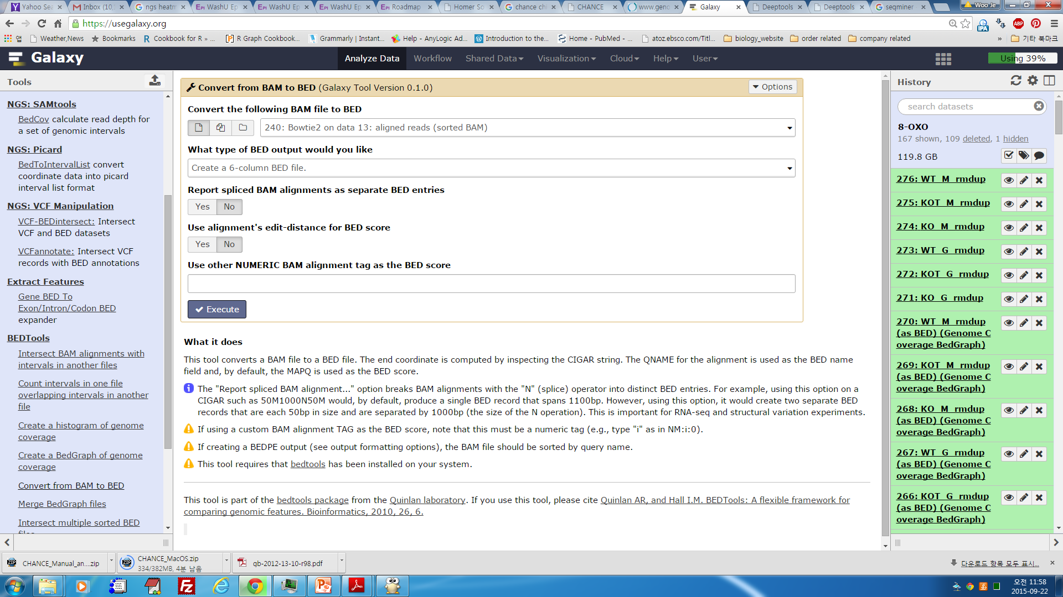
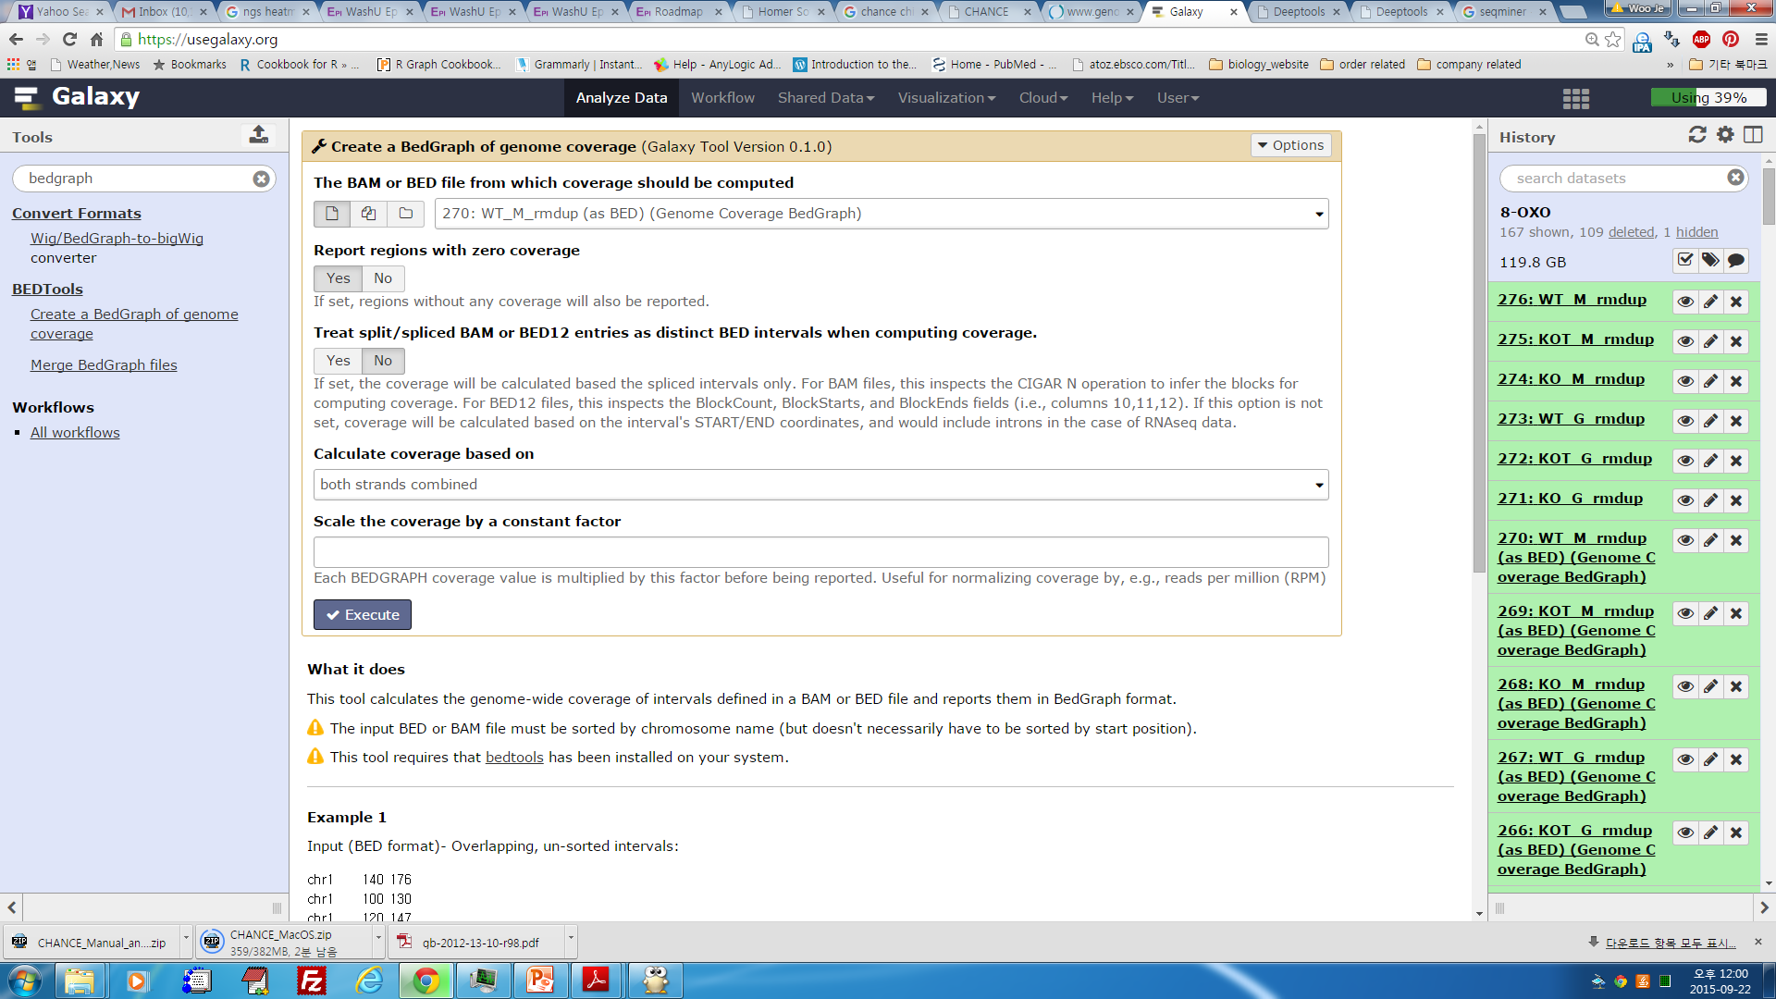
3) UCSC visualization using Galaxy
BAM
BAM to SAM
BAM to Bed
Bed to BedGraph
BedGraph to bigwig

Slide 43
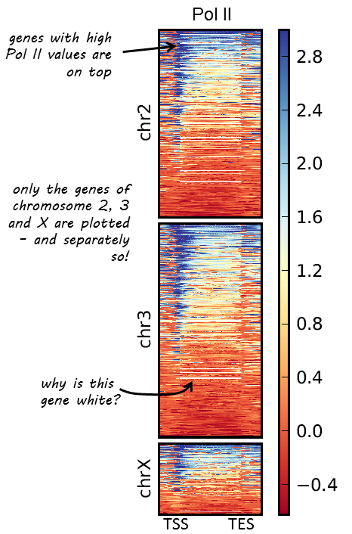
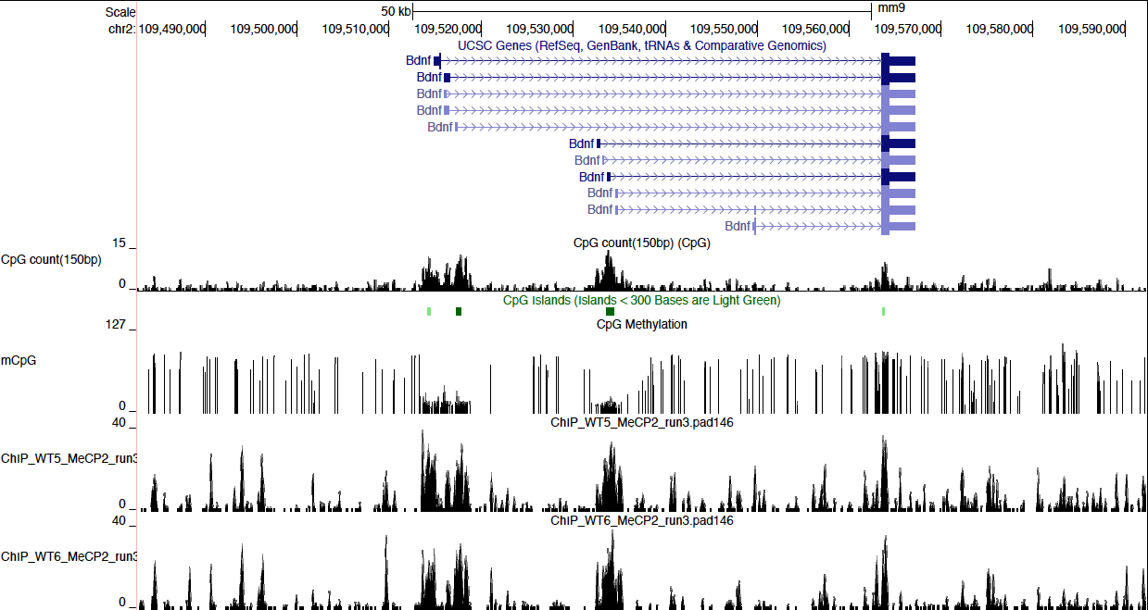
Visualization using other programs
https://deeptools.github.io/
http://deeptools.ie-freiburg.mpg.de/
https://pypi.python.org/pypi/deepTools
Or Visit https://github.com/shenlab-sinai/ngsplot

Slide 44
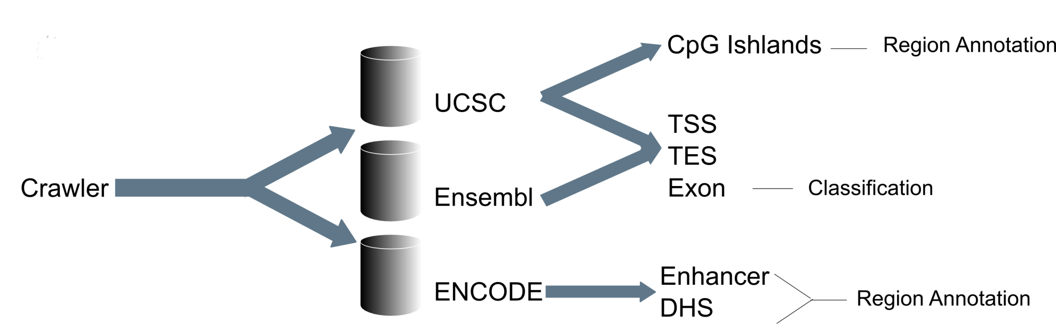

ngs.plot collects lots of genome annotations
Visualization using other programs
Variable | Count | Description
Database | 3 | Refseq , Ensembl and ENCODE
Genome | 9 | dm3, hg19, mm10, mm9, rn4, rn5, sacCer3, Tair10, Zv9
Biotype | 7 | tss, tes, genebody, cgi, dhs, enhancer, exon
Gene type | 4 | protein_coding, lincRNA, miRNA, pseudogene
Cell line | 9 | Gm12878, H1hesc, Hepg2, Hmec, Hsmm, Huvec, K562, Nhek, Nhlf
Total functional elements: 15,944,952

Slide 45
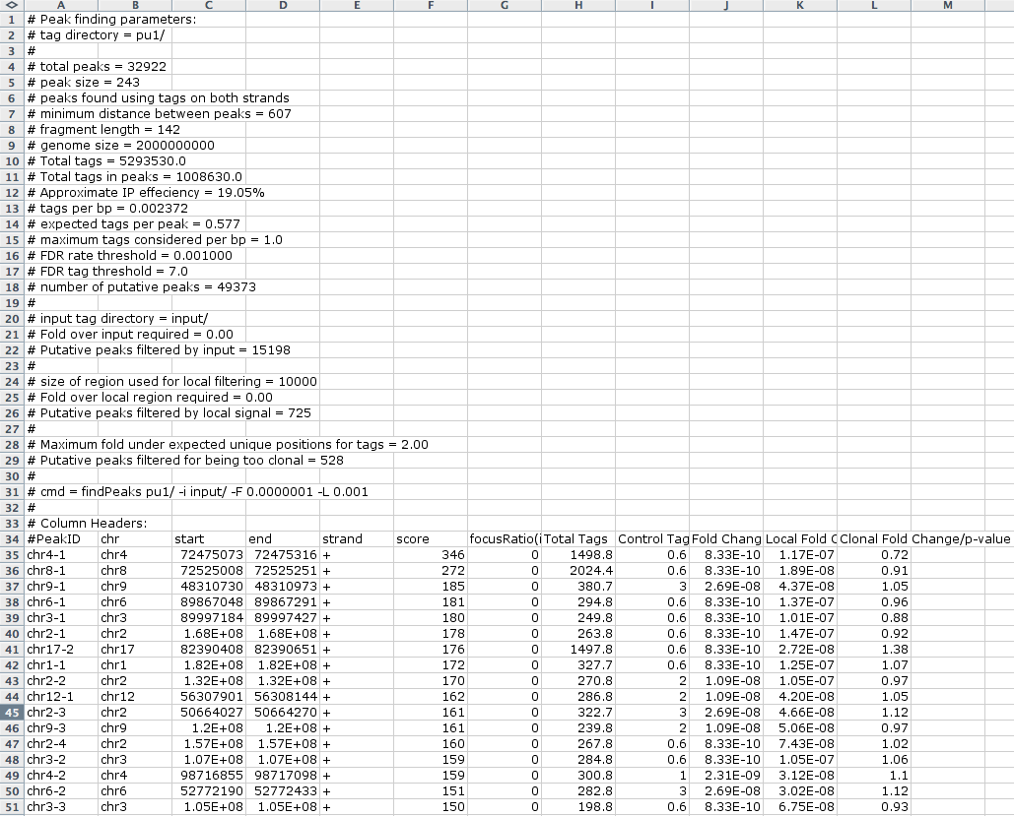
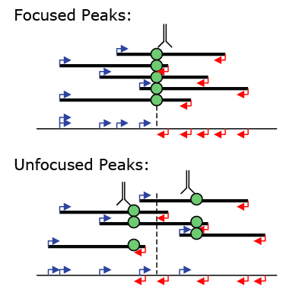
4) Peak finding / Transcript detection / Feature identification (findPeaks)
Finding Transcription Factor Peaks with HOMER
To find peaks for a transcription factor use the findPeaks command: i.e. findPeaks ERalpha-ChIP-Seq/ -center -o ERalpha.peaks.txt

Slide 46
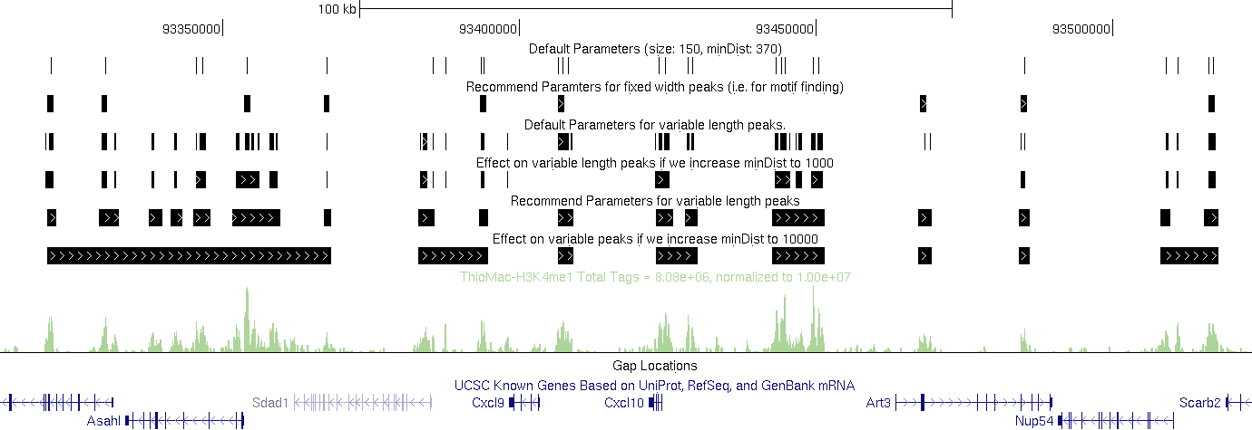
4) Peak finding / Transcript detection / Feature identification (findPeaks)
Finding Enriched Regions of Variable Length
Column 1: PeakID - a unique name for each peak (very important that peaks have unique names...)
Column 2: chr - chromosome where peak is located
Column 3: starting position of peak
Column 4: ending position of peak
Column 5: Strand (+/-)
Column 6: Score - number of tags found clustered together (may differ from total tag count depending on how many tags were considered per bp)
Column 7: Focus Ratio - fraction of tags found appropriately upstream and downstream of the peak center. Describes the chances that factor binds a single spot on the DNA. (will be set to zero if -center was NOT used)
Columns 8+: Statistics and Data from filtering

Slide 47
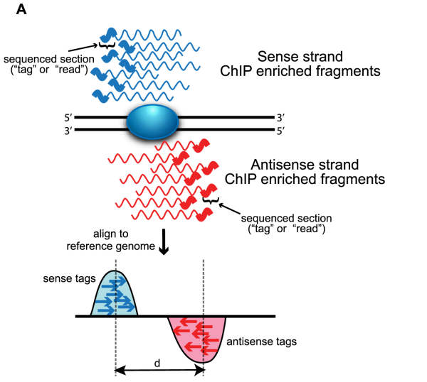

4) Peak finding / Transcript detection / Feature identification (findPeaks)
Computation for ChIP-seq data analysis
A
B
Proteins that bind DNA in a site-specific fashion.
ChIP-seq peak calling subtasks.
Shirley Pepke et al., 2009

Slide 48

6) Annotation of Peaks (annotatePeaks.pl)
Annotating Peaks
annotatePeaks.pl <peak file> <genome> > <output file> i.e. annotatePeaks.pl ERpeaks.txt hg18 > outputfile.txt

Slide 49
NGS 분석을 활용한 연구 실례

Slide 50

Example

Slide 51

Methyl CpG binding Protein 2 (MeCP2)
Sara is eight years old & has Rett Syndrome.
http://princesshappyheart.blogspot.com/
Roberta M and Hendrik G., 2014
Kamal K.E. Gadalla et al., 2011

Slide 52





Methylated DNA enrichment using MBD protein and MeCP2 Ab
MBD-seq
MeCP2 ChIP-seq

Slide 53

Comparative analysis of Whole-Genome Bisulfite Sequencing
Biological replicate of whole-genome bisulfite sequencing.
B and C. Comparative analysis with previous studies.

Slide 54

MeCP2 enrichment depends weakly on mCpG%
A
B
The screenshot showing CpG islands, methyl-CpG(Bis-seq), MeCP2-bound sequences data for the 100kb region of chromosome 2.
Mean MeCP2 enrichment (purple), and mCpG% (red) around proximal and distal (dashed) CGIs.

Slide 55



Mnase-seq

